Slide 1
Satellite Imagery
Pictures that are taken from satellites that are orbiting the Earth.

Slide 2
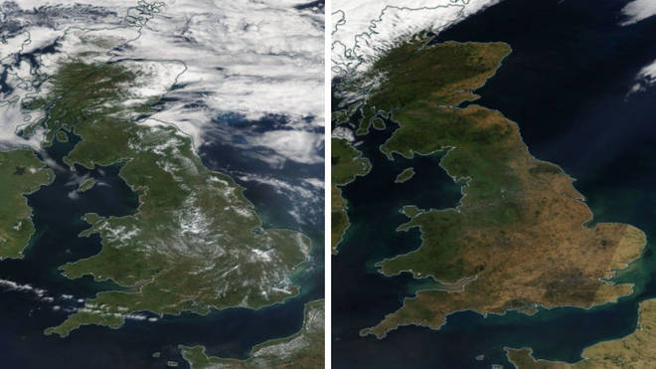
What are the similarities and differences between these two satellite images?
Source: NASA World View
Notes:
Similarities: pictures of the United Kingdom, we can see green land in both, the blue sea, some white as well (chn may think this is snow, it is actually clouds)
Differences: there is more white (clouds) on the first picture, there is more yellow over the South, South East and East of England

Slide 3
Do you have any questions about the pictures?
Source: NASA World View

Slide 4
This picture was taken of the United Kingdom from a satellite in July 2021
Source: NASA World View

Slide 5
This picture was taken in August 2022
Can you remember what the weather was like in the summer?
Why is this image different to the other image?
Source: NASA World View
Notes:
We had a very hot, dry early summer which saw lots of England in drought conditions. The yellow colour comes from where the land was scorched and lacking water so the plants were not healthy and green.

Slide 6
What is one challenge you can see with satellite imagery? (click for the answer)
Why could this be a problem?
Clouds!
Source: NASA World View
Notes:
Satellite imagery is above our cloud level and therefore if it is cloudy the images are blocked by the clouds. We are finding ways of using older images and Artificial Intelligence to predict what it would look like underneath the image but this is still new and being developed.

Slide 7
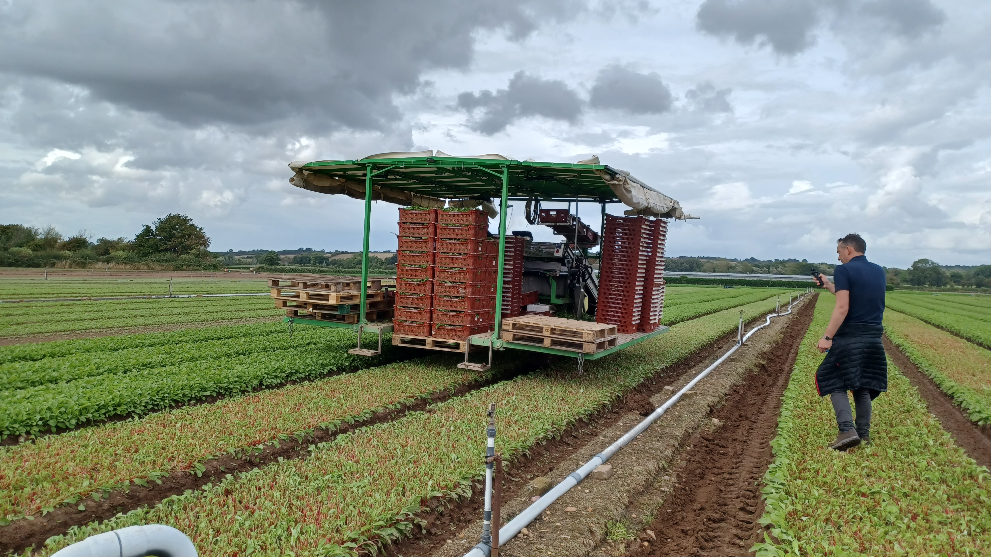
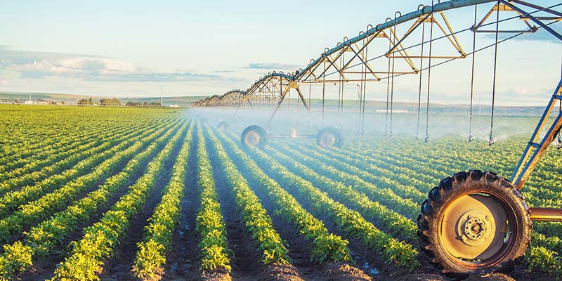
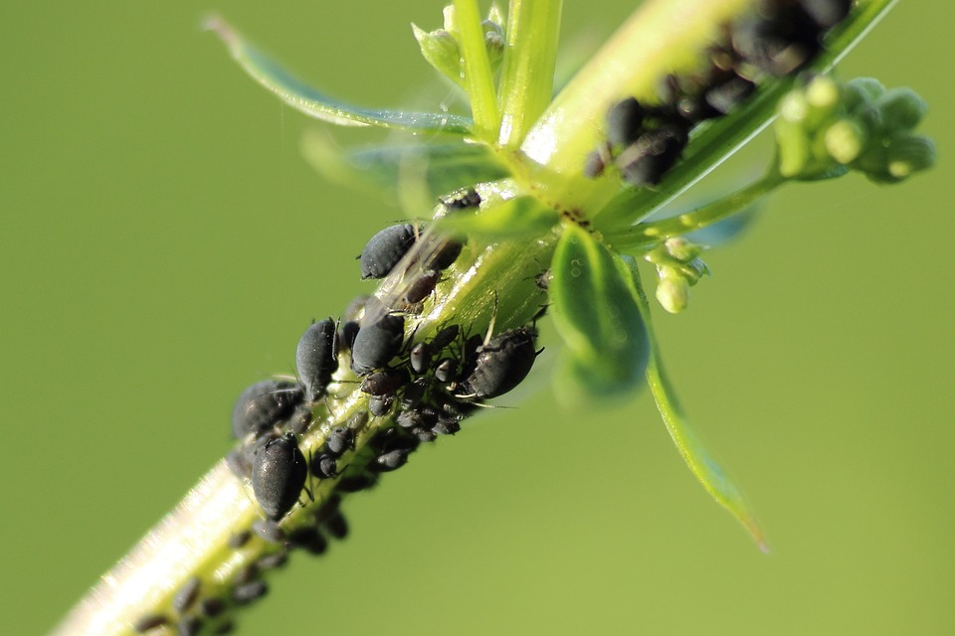
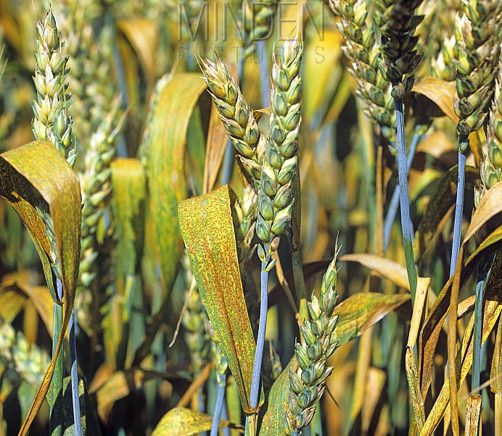
How can farmers use satellite imagery?
Think about what a farmer might need or want to know about their crops that they could see from a satellite image?
From satellite images farmers can tell….
If plants need water
When crops will be ready to harvest (harvest prediction) and how much crop (yield) there will be to harvest.
If plants are being affected by pests…
or disease
Farmers can then use this information to make an informed decision on what action to take next.
Notes:
If plants need water…you can see a field being irrigated. We can tell from images if plants need water and where in the field might need more or less than the rest.
When crops are ready to harvest…picture shows lettuces being harvested. We can tell from the images how much leaf cover there is so how much crop there is to be harvested and how ready the crop is to be harvested.
If plants are affected by pests… this picture shows aphids which feed on farmers’ crops, damaging leaves and spreading disease.
Disease.. This picture shows Brown Rust, a disease that reduces the plant’s ability to photosynthesise (make food) so reduces its quality and yield (amount of grains it produces)

