Slide 1
Which animal am I ?
Ask a question to see if you can work out which animal I am. I can only answer yes or no…

Slide 2
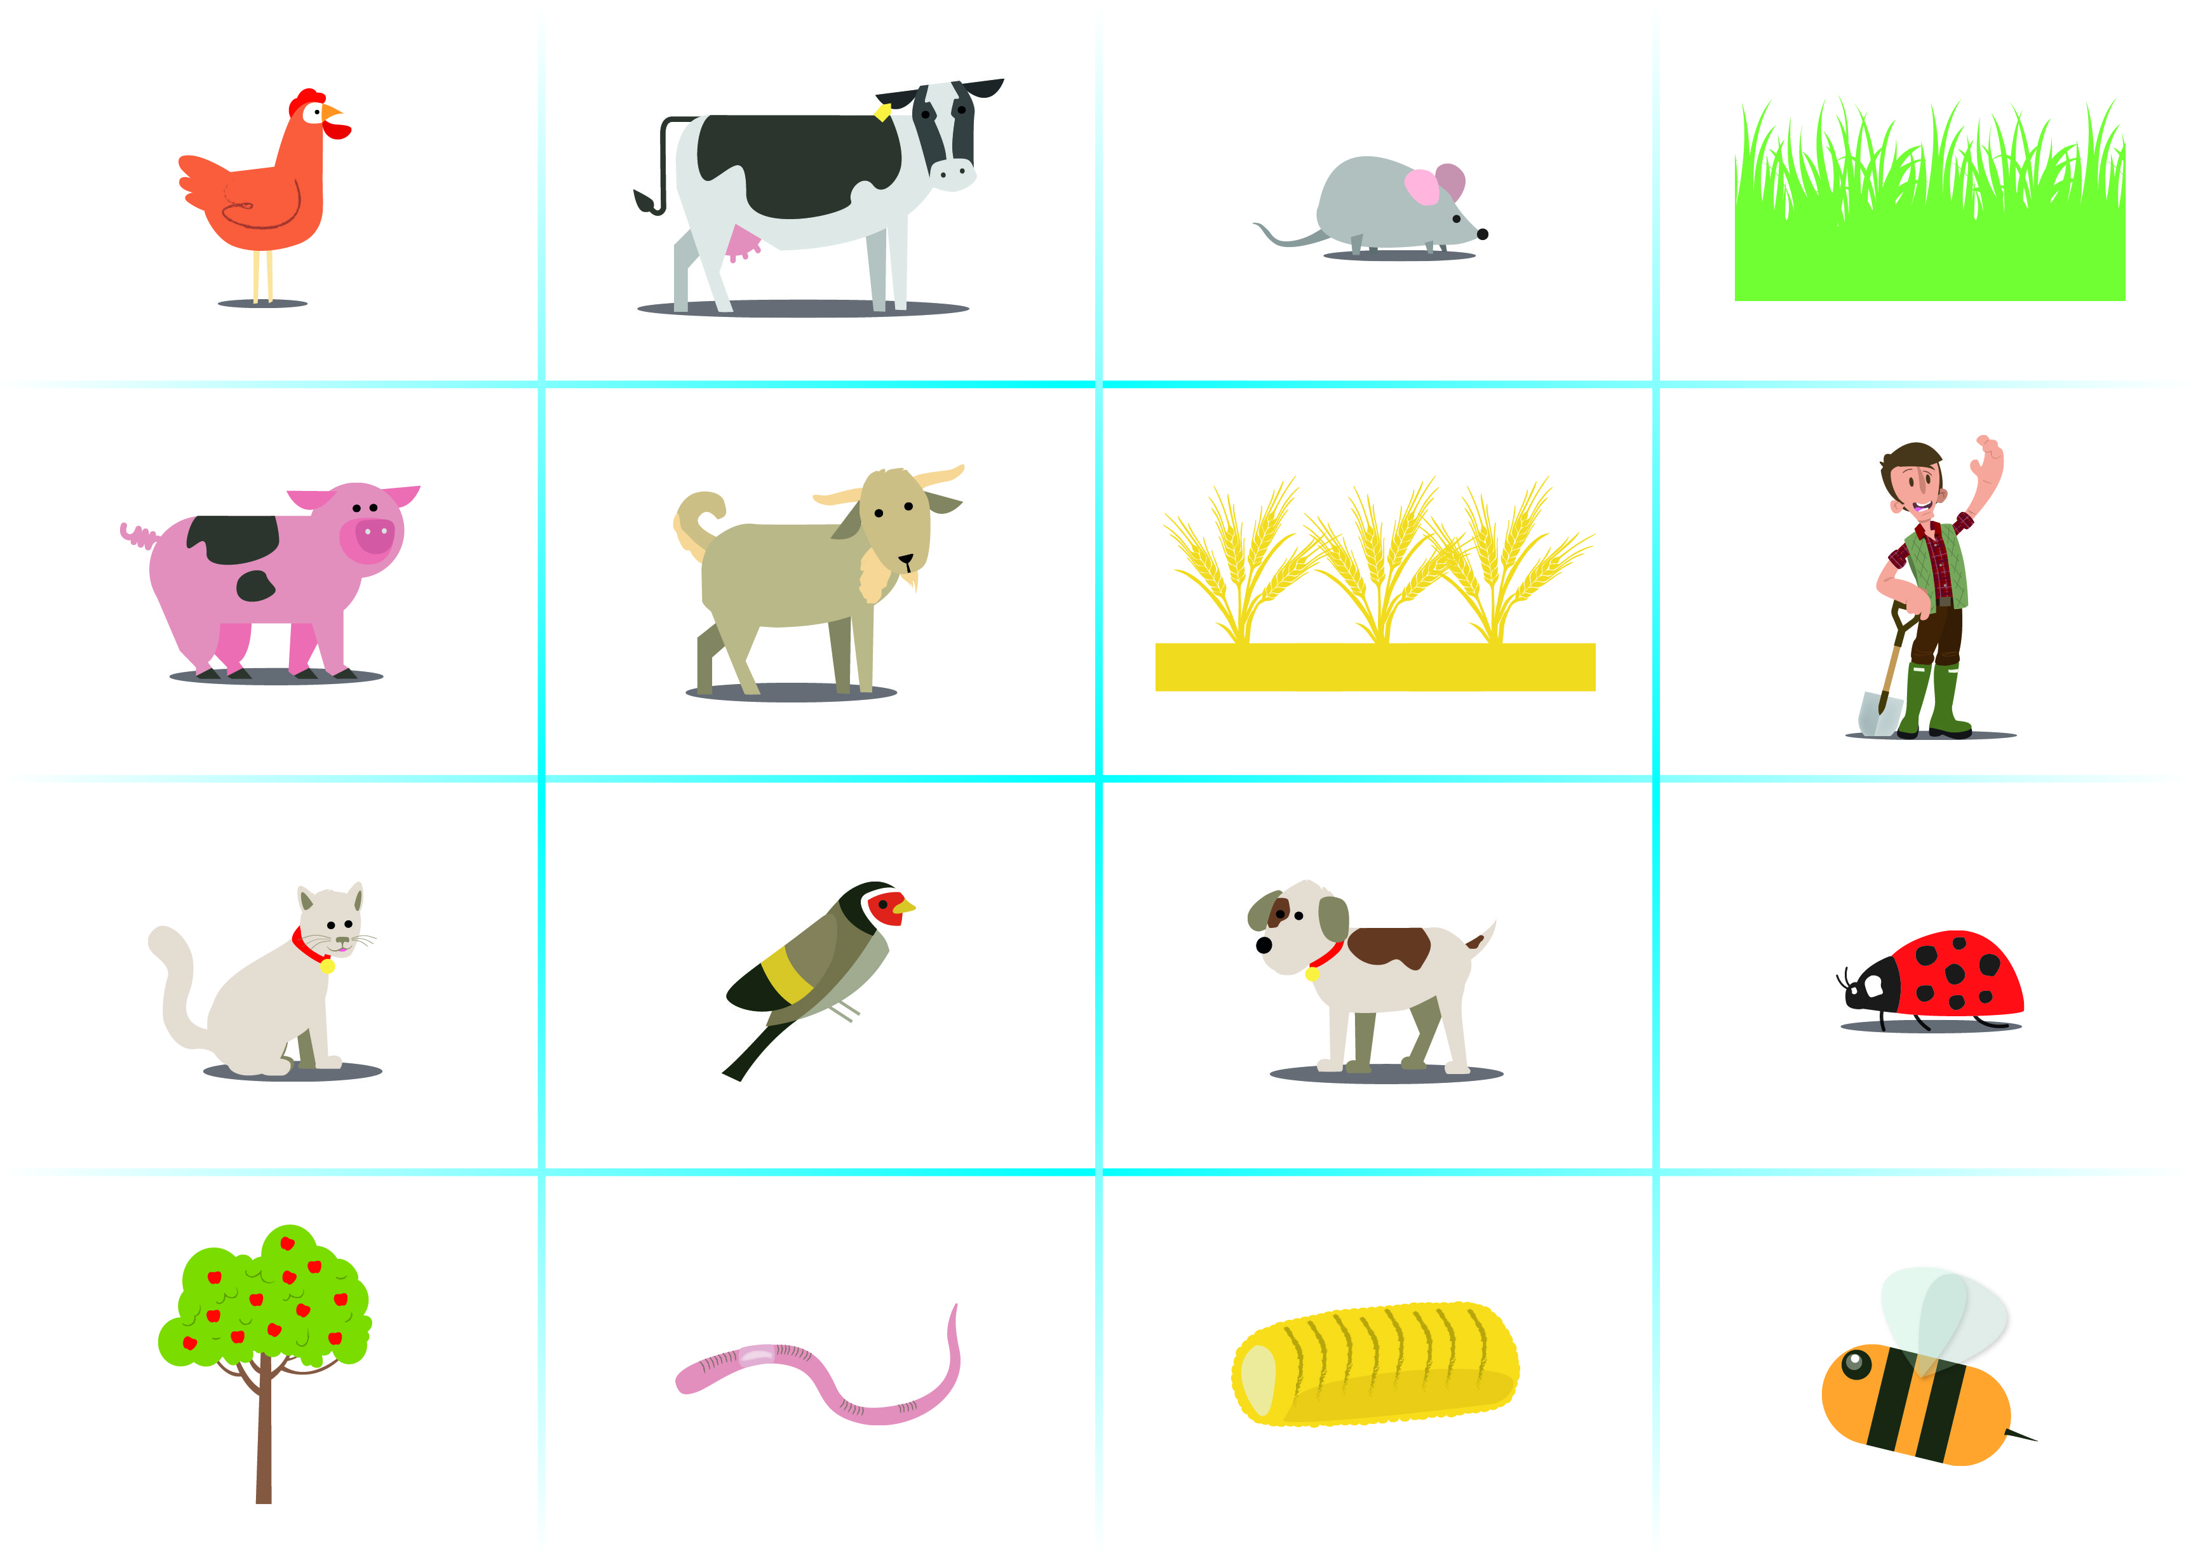

Slide 3
For more exciting science resources go to www.nfuonline.com/schools

