Slide 1
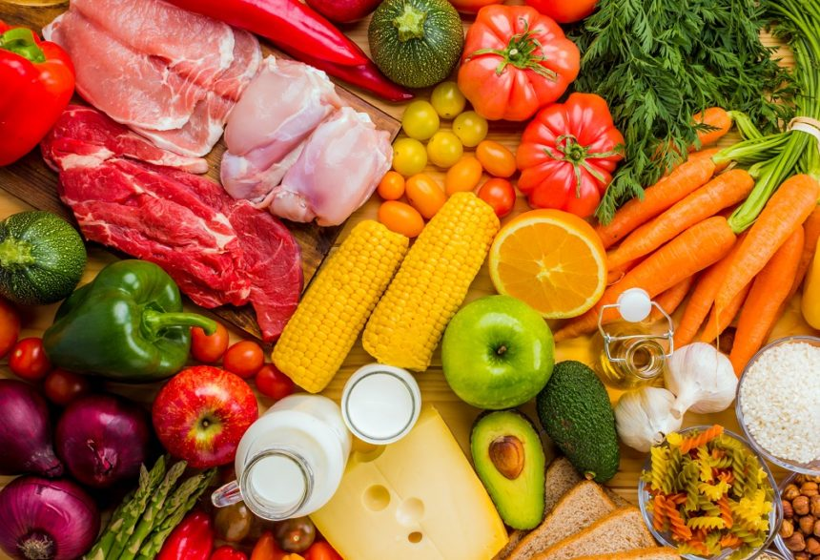
STARTER:
In your groups, see if you can separate your cards into two piles.
You will need to justify your choices.

Slide 2
Starter feedback
One way that they might be sorted is to separate foods that are produced commercially in the UK, and foods that are not. For example:
Pile A: Carrots, lamb chops, potatoes, apples, eggs and strawberries can all be produced naturally in the UK.
Pile B: Coffee beans, bananas, kiwi fruit and cocoa beans will all go into this pile because they do not naturally grow in the UK’s climate.

Slide 3
Starter feedback
One way that they might be sorted is to separate food that is produced commercially in the UK, and food that is not.
Garlic | Potatoes | Apples | Coffee beans | Cocoa | Avocado
Pork sausage | Wheat | Beef burger | Rice | Pineapples | Oranges
Strawberries | Asparagus | Lamb chops | Bananas | Coconuts | Blueberries
Oats | Pears | Rhubarb | Kiwi Fruit | Chilli beans | Soya
Eggs | Barley | Milk | Goji berries | Tea | Crocodile steak
Blackberries | Cauliflowers | leek | Mango | Papaya | Olives

Slide 4
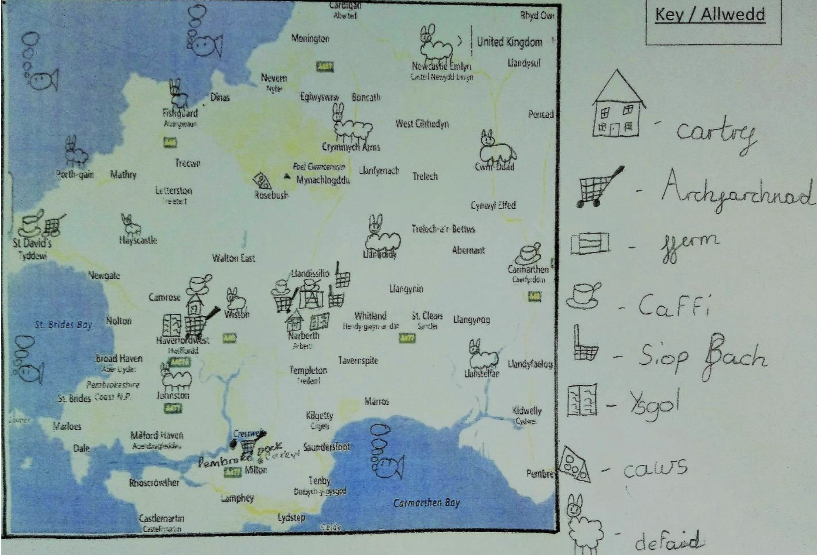
Activity One:
Creating a personal food map
A) Think of all the places we associate with food and create a symbol for each of them. This will form your key to demonstrate the different places you might source food from in your area. For example, home, supermarket, corner shop, school canteen, local market etc.
Using your key, label your map with the different places in your key.

Slide 5
What are the advantages and disadvantages of buying from supermarkets versus local shops?
Record your thoughts using a table like the one below.
+ Supermarkets
+ Local shop
- Supermarkets
- Local shop

Slide 6
Activity Two: Local food producers
Now let’s think about the food that is produced locally.
As you conduct your research, label the food producers on your map.
Conducting your research.
What could you use to research local food producers?

Slide 7
Homework
Collect a range of food labels and packets, preferably locally produced.
Bring them with you to the next session.

Slide 9
Your Challenge:
Design a new product that could be sold at a local farm shop. It should be made by sourcing your main ingredients locally. For example, you could make vegetable soup using only locally grown vegetables. Use the map you created to help you to remeber what is available locally.
Clarification Corner: Farm shop
A farm shop will sell…….
One example of a local farm shop is…
Considerations:
Ingredients. What is available locally?
Target audience. Who will be your consumer?
Competition. What else is already available locally and what makes your product better or unique?
Price. Will your product be competitive?
Selling point. Why buy your product? Is it healthy? A tasty treat?
Brainstorming: Potential products

Slide 10
Powers of persuasion
Marketing a product is always very carefully considered, from colour and image choices, to logo and slogans, and the material your packaging is made out of. Let’s start with the text. Can you remember your persuasive devices...?

Slide 11
Powers of persuasion
Pull out the examples of packaging you have brought with you and have a good look at them. Which of these devices can you spot? Copy the example onto your post-it and stick it onto the board in the appropriate place.
Rhetorical Question | Alliteration
Tripling/ Rule of three | Powerful adjectives or adverbs
Hyperbole/ exaggeration | Facts and figures
Opinion presented as fact | Slogan

Slide 12
Product Packaging
The text on your packaging is uber-important! But, it’s not the only thing that can be used to attract your customer and persuade them to buy!
What other factors do you think are important when designing packaging?
Now let’s look at a few examples. How have each of them tried to attract the consumer?

Slide 13
Text: What product information can you find? Why include it?
What do you notice about the layout of the text? Can you spot any language devices used to persuade you to purchase or to make the text more catchy?
Images: What about the images used? What do they imply about the product?
Colours: What do you notice about the colours used?
Packaging: What about the packaging itself? How do the colour, material and shape reinforce ideas about the product?

Slide 14
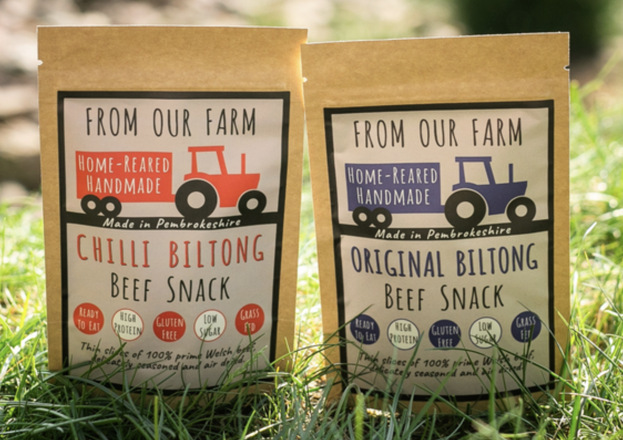
Text: What product information can you find? Why include it?
What do you notice about the layout of the text? Can you spot any language devices used to persuade you to purchase or to make the text more catchy?
Images: What about the images used? What do they imply about the product?
Colours: What do you notice about the colours used?
Packaging: What about the packaging itself? How do the colour, material and shape reinforce ideas about the product?
Thin slices of 100% prime Welsh beef, delicately seasoned and air-dried.

Slide 15
Blas y Tir roughly translates as ‘flavour of the land’.
Text: What product information can you find? Why include it?
What do you notice about the layout of the text? Can you spot any language devices used to persuade you to purchase or to make the text more catchy?
Images: What about the images used? What do they imply about the product?
Colours: What do you notice about the colours used?
Packaging: What about the packaging itself? How do the colour, material and shape reinforce ideas about the product?

Slide 16
In pairs, choose two examples of packaging from your table. Have a go at analysing it. Use the table to guide you.
Product Name | Text: What product information can you find? Why include it? What do you notice about the layout of the text? Can you spot any language devices used to persuade you to purchase or to make the text more catchy? | Images: What about the images used? What do they imply about the product? | Colours: What do you notice about the colours used? | Packaging: What about the packaging itself? How do the colour, material and shape reinforce ideas about the product?

Slide 17
Now for your product’s packaging. It’s time for a brainstorm. Use a spider diagram to record your ideas. Remember that the packaging should always consider the consumer. Think about text, materials, images, colours, fonts, potential slogans, images etc.

Slide 18
Draw and label a diagram of your packaging. Lebeling should include details of the reasons for your choices. E.g. You will need to justify your choice of colour.

Slide 20
Starter:
Can you unscramble each anagram to reveal a persuasive device?
Oershteutoriqcalin
Ertulheeofr
Heylpoebr
Laiileatrotn
Rhetorical question
Rule of three
Hyperbole
Alliteration
Can you give me two more?

Slide 21
In order to get your business off the ground, you need investment. In order to secure investment, you need to create:
a presentation pitching your idea;
a product display board clearly outlining your product and ideas;

Slide 22
Aiming higher? Some optional additions....
As well as the work you have already done, you could consider adding one or more of the following to your pitch:
An advert (this could be print or digital)
A consumer survey such as a taste test
A sample
Packaging prototype
A press release
The winning pitch secures the prize!

Slide 23
Planning your pitch
You have one lesson to plan. You may use only what can be found in this room during this time. You may continue to work on your pitch in your own time between now and the next lesson. It is up to you how hard you are willing to work to secure a succesful pitch!

Slide 24
What to include in your presentation?
What to include on your display board.

Slide 25
Plenary:
Check through your presentation note. Have you included language devices in your text? Highlight them to ensure that you have a balance throughout your pitch.

Slide 27
Before we begin our pitches, let’s consider what makes a successful presentation and what makes a good audience.
Do
Don’t

Slide 28
Self reflection and evaluation
It’s time to reflect on your time completing this project.
What have you learned about food and food production in your area?
What did your group do particularly well?
In what ways do you think you or your group could improve?
Would you do anything differently next time around?
What have been your strengths in approaching this project? E.g. communication, time management, leadership, team-work, creativity, effective research, resilience.

Slide 29
Garlic | Potatoes | Apples | Coffee beans | Cocoa | Avocado
Pork sausage | Wheat | Beef burger | Rice | Pineapples | Oranges
Strawberries | Asparagus | Lamb chops | Bananas | Coconuts | Blueberries
Oats | Pears | Rhubarb | Kiwi Fruit | Chilli beans | Soya
Eggs | Barley | Milk | Goji berries | Tea | Crocodile steak
Blackberries | Cauliflowers | leek | Mango | Papaya | Olives

