Slide 1



SAMPLE
Learning Without Walls
Lesson 3
COMMUNITY AWARD
winner 2009/10

Slide 2
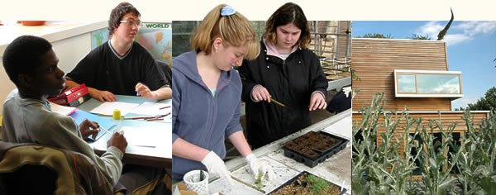
Roots & Shoots
This is a project to discover
the way a seed germinates.
Each student will create their own seed
container/propagator and watch as the
Bean produces its shoot and root
SAMPLE

Slide 3
What we will learn?
Seed germination –
Swelling, root development
&
shoot (stem & leaf) growth.
The requirements of seeds –
Water, light & dark, warmth.
Direction of roots & shoots
SAMPLE

Slide 4
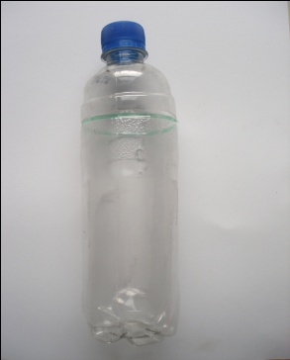
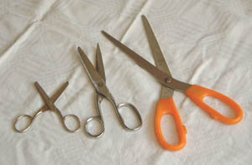
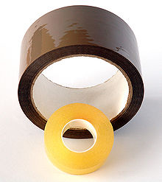


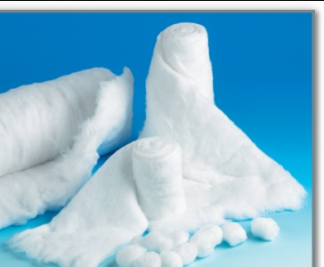
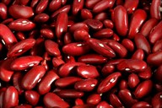
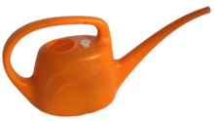
Equipment required
Small plastic water bottle
Scissors
Sellotape
Pen
Black sugar paper or card
Kitchen towel or cotton wool
Broad bean seed
Watering can/jug
SAMPLE

Slide 5

Equipment required
Small plastic water bottle
The green line is where you cut the bottle
SAMPLE

Slide 6
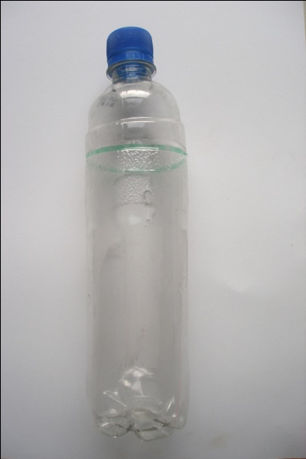
What you have to do?
Take your small plastic water bottle and remove the label from around it. You need the bottle to be completely clear in order to see the germination
Make a small hole on the side where the top of the bottle starts to slope in at the neck. You can draw a line on the bottle
to allow the student to cut along
it and create his or her own
container.
SAMPLE

Slide 7
What you have to do?
You now need to half fill your container with damp kitchen roll or cotton wool. It needs to be well packed but not tightly squeezed in.
Take your broad bean seed and place it upright against the side of the container.
It is important that the bean is standing upright, as this is how it will sprout so you can clearly see. Also to stop it lying in too much water and possibly rotting.
SAMPLE

Slide 8
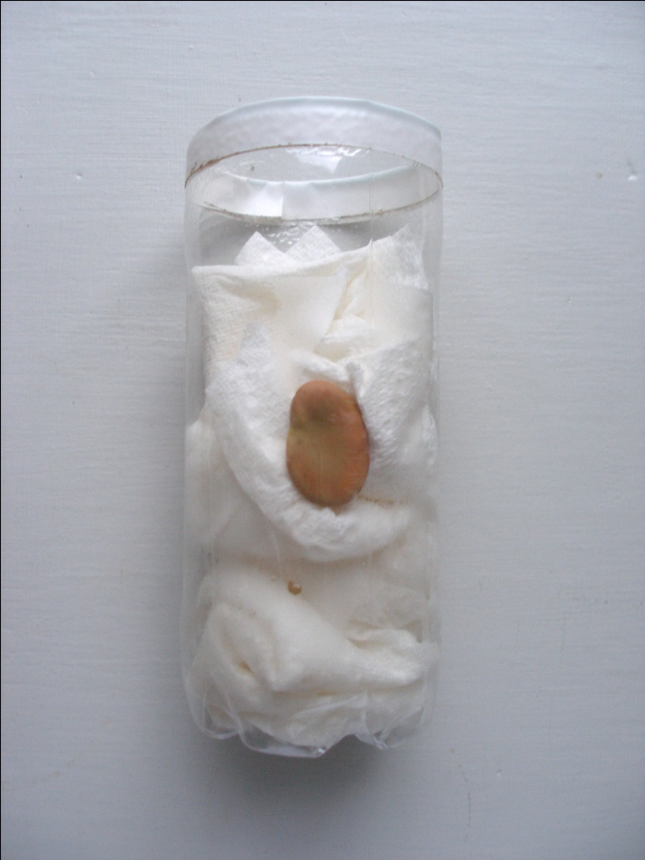
Planting the bean seed
Take your broad bean seed and place it upright
against the side of the container.
It is important that the bean is standing upright, like this, so you can clearly see how it will sprout. This position will prevent it lying in too much water and possibly rotting.
SAMPLE

Slide 9
What you have to do?
Fill the rest of the container with kitchen roll so the seed stays in place and is clearly viewable.
Cut a piece of black paper/card to the same height as your container and long enough to wrap around the bottle so it is completely covered. Make sure that the card is loose enough to slide off the bottle so you can view the seeds development. Secure with a piece of sellotape.
SAMPLE

Slide 10
What you have to do?
Each student writes their name on the card and container too. Be sure to write the date of when you first sowed the seed to keep a diary of its progress.
You can now place your containers in a warm light place. Preferably a windowsill that is secluded from any drafts.
SAMPLE

Slide 11
What you have to do?
Your seed will need to stay damp and will occasionally need watering. With a watering can or jug, carefully pour some water into your container. You only need to put around 2 cm’s of water into the bottom of the bottle and the kitchen roll will soak it all up.
SAMPLE

Slide 12
What you have to do?
Leave your seeds and take a look at them everyday by carefully lifting the card sleeve. You will soon start to see the root breaking from the seed and then the shoot.
Don’t worry if the seed was put the wrong way up. This is a good experiment to watch the roots and shoots coming out the wrong way round and making a full U-turn to go the correct way. The roots will know to head for the dark and the shoots will know to head for the light.
SAMPLE

Slide 13
What you have to do?
If you wish to plant these out then you will need to do it before the seed starts developing any leaves as too much energy would be used up without the nutrients from soil and will produce weak plants. You will need to carefully tip the bean and paper from the container and place into a deep enough hole in the soil to not break the root. Placing it deep enough for the tip of the shoot to just be showing on the surface of the soil.
SAMPLE

Slide 14


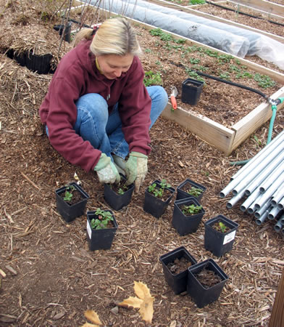
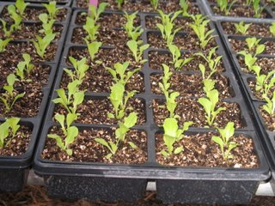

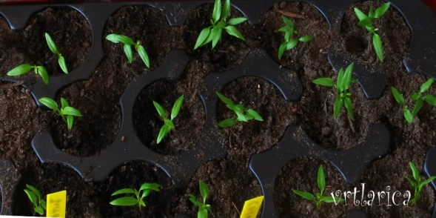
Transplanting
SAMPLE

Slide 15
What we can then do?
Discuss and record the main features of the root and shoot developments.
Relate the growth rate to the passage of time
and especially the rate of growth of the shoots when re-planted in soil
As well as recording the growth in writing, also ensure that drawings are made and, perhaps, photographs taken
Explain what has been observed
Prepare for and set up a display of work
SAMPLE

