Slide 1
Conscious Consumers

Slide 2
Food miles

Slide 3
What are food miles?
For this workshop you will need:
Food miles activity sheets
Food miles ingredient cards
A calculator
Food miles is the term used to describe the distance food is transported from the place its produced to the end consumer (us).
The effect of food miles is measured by the amount of CO₂ emissions produced, this is usually measured per tonne of food per kilometre.

Slide 4
What are our food miles?
To explore our own food miles we are going to do activity number 1.
We are going to look at the origin of the top 5 ingredients of three popular dishes and work out the food miles for each dish.
The dishes we will be looking at are:
Roast Dinner
English Breakfast
Chicken Burrito
Beef
Potato
Carrot
Onion
Broccoli
Eggs (free range)
Tomato
Baked Beans
Bacon
Button Mushrooms
Chicken (free range)
Rice
Avocado
Lime
Peppers

Slide 5
Estimated food miles
Activity sheet 1
1. Choose a dish and its ingredients
2. Where do you think the ingredient is produced?
- Take a guess.
3. How far has it travelled? Figure out the distance from the origin.
Roast Dinner
Ingredient | Origin | Miles
Beef
Potato
Carrot
Onion
Broccoli
4. What’s the total number of miles your dishes ingredients have travelled?
Repeat for all three dishes
Total

Slide 6
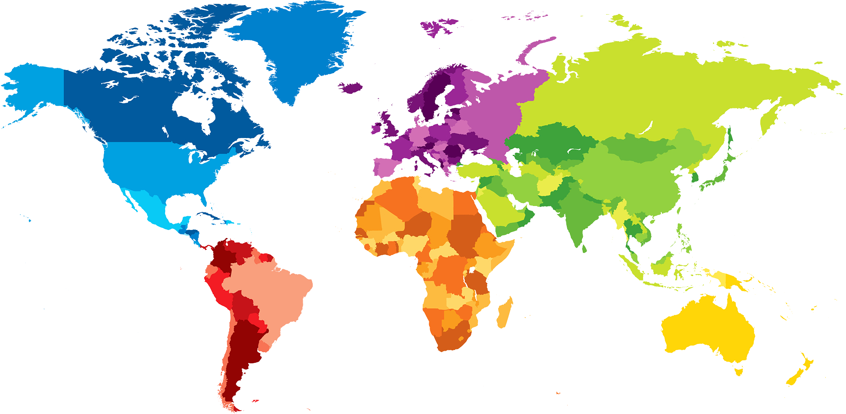
How many food miles?
Try this resource
(Example distances between some major cities and Norwich)
Egypt
(Cairo)
2100 miles
https://www.foodmiles.com/results.cfm
Canada
(Toronto)
3500 miles
China
(Beijing)
5000 miles
Mexico
(Mexico City)
5500 miles
Chile
(Santiago)
7300 miles
Australia
(Canberra)
10400 miles
Spain
(Madrid) 870 miles
India
(Delhi)
4100 miles

Slide 7
Please complete activity number one

Slide 8
Actual meal food miles
Now lets look at what the actual food miles of our dishes are.
The origin of each ingredient is reported according to a leading supermarket during the winter of 2019
Notes:
Note:
Eggs were bought free range – what difference would it make if they were sourced differently, would it affect the food miles?
Baked beans – these are a processed ingredient and require more than one ingredient (haricot beans, tomato etc) so the food miles are higher.

Slide 9
Roast Dinner
Low food miles due to the ingredients being produced in the UK and Europe.
Ingredient Origin Miles
Beef
Potato
Ireland 320
Cornwall 300
France 260
Carrot
Onion
Netherlands 150
Broccoli
Spain 870
Total food miles
1,900

Slide 10
English Breakfast
Baked beans are a large contributor of food miles in this meal as the haricot beans used to make the baked beans are grown in North America, in this case Idaho.
Ingredient Origin Miles
Eggs
Tomato
Baked Beans
Bacon
Mushrooms
Gloucestershire 160
Morocco 1500
Idaho, USA 4750
Denmark 400
Netherlands 150
Total food miles
6,960

Slide 11
Chicken Burrito
Lime and avocados are exotic ingredients that can not be grown in the UK so have to be imported. This has led to the high food miles of this meal.
Ingredient Origin Miles
Chicken
Rice
Avocado
Lime
Peppers
Hertfordshire 80
India 4100
Chile 7300
Mexico 5500
Israel 2200
Total food miles
19,180

Slide 12
Estimate v’s actual miles
What is the difference between your estimated food miles and the actual food miles?
Did you find anything surprising?
Total actual food miles for all three meals:
28,040

Slide 13
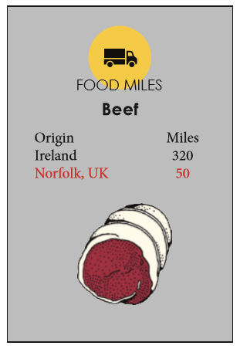
Cutting down on food miles
Activity 2
- Buying locally
There are many benefits to buying locally, it helps your local economy, the produce is often fresher, less packaging is involved and it can cut down your food miles!
Going back to the dishes we bought earlier, can we buy these ingredients more locally to cut our food miles?
Use the ingredient cards to see if you can source the same ingredients, more locally.
Roast Dinner
Ingredient | Origin | Miles
Beef | Norfolk | 50
Potato
Carrot
Onion
Broccoli
 | Total
*Note:
50 miles is allocated to produce from Norfolk to cover the miles taken to transport the ingredient from the producer to the supermarket

Slide 14
Please complete activity 2
Use the ingredient cards and make a note of any ingredients you choose that are in a red font!

Slide 15
Activity 2 Answers.
- Buying locally
Roast Dinner
English Breakfast
Ingredient | Origin | Miles
Beef | Norfolk | 50
Potato | Norfolk | 50
Carrot | Norfolk | 50
Onion | Norfolk | 50
Broccoli | Norfolk | 50
 | Total | 250
Ingredient | Origin | Miles
Eggs (free range) | Norfolk | 50
Tomato | Spain | 870
Baked Beans | Michigan, USA | 3700
Bacon | Norfolk | 50
Button mushrooms | Netherlands | 150
 | Total | 4820
?
Red font ingredients. These ingredients were not available at the supermarket where our data was collected but they can be produced locally and bought if you travel to an alternative local supermarket. Would you travel to an alternative supermarket to buy more locally grown produce, or would you buy less locally produced ingredients from your regular supermarket?

Slide 16
Buying Locally
Combined food miles (from activity 1)
28,040
Chicken Burrito
- minus
Ingredient | Origin | Miles
Chicken (free range) | Hertfordshire | 80
Rice | India | 4100
Avocado | Dominican Republic | 4420
Lime | Spain | 870
Peppers | Netherlands | 150
 | Total | 9,620
Combined food miles (from activity 2)
14,690
Total miles saved:
13,350

Slide 17
But what does this reduction in food miles equate to?

Slide 18
How is our food transported?
Road Transport
Air Transport
Sea Transport
Rail Transport
60%
20%
10%
10%
*Of all food globally

Slide 19
CO2 Emissions
Sea Transport
Road Transport
Rail Transport
Air Transport
10%
60%
10%
20%
Least CO₂ emitting form of food transport.
30 grammes per tonne of food per kilometre
Most CO₂ emitting form of food transport
1500 grammes per tonne of food per kilometre
More emissions are created by the drive to the supermarket to buy air freighted food than created by the air freighting
www.alimentarium.org/en
Notes:
Km ~ 0.6 mile

Slide 20
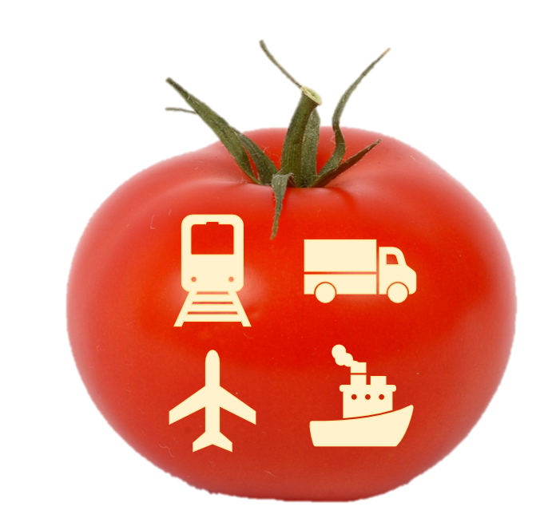
Lets calculate..
In activities 1 and 2 we looked at a selection of meals and explored how we could reduce our food miles by buying more locally produced food. Now lets look at another example in more detail.
Around only 20% of all tomatoes consumed in the UK are grown here.
The remaining percentage are imported from countries including South Africa and Morocco.

Slide 21
Calculating CO₂ emittance
Activity 3
(this is worked out in kilometres instead of miles)
Food origin
Lancashire
Morocco
South Africa
We are moving 1 tonne of tomatoes by:
Which has a CO₂ footprint of:
30gm/tonne/km
120gm/tonne/km
1500gm/tonne/km
Work out the total CO₂ emittance for each journey.
The distance being travelled is:
300km
2166km
9513km
Total CO₂ emittance
for this journey is:

Slide 22
Activity 3 - answers
Food origin
Lancashire
Morocco
South Africa
We are moving 1 tonne of tomatoes by:
Which has a CO₂ footprint of:
30gm/tonne/km
120gm/tonne/km
1500gm/tonne/km
The distance being travelled is:
300km
2166km
9513km
Total CO₂ emittance
for this journey is:
36,000gm
64,980gm
14,269,500gm

Slide 23
Buying locally
By buying the British grown tomatoes instead of the tomatoes imported from Morocco we could reduce our CO₂ emittance by 28,980 gm per tonne per km.
And by buying British grown tomatoes instead of tomatoes imported from South Africa, we could reduce our CO₂ emittance by 14,233,500 gm per tonne per km.
Minimum CO₂
saving
Maximum CO₂
saving
28,980gm
14,233,500gm
Per tonne.
Per tonne.

Slide 24
That’s the equivalent saving in weight of
Minimum
Maximum
14
7,116
But is it a clear cut story?
Full 2L drinks bottles (2Kg)
Full 2L drinks bottles (2Kg)

Slide 25
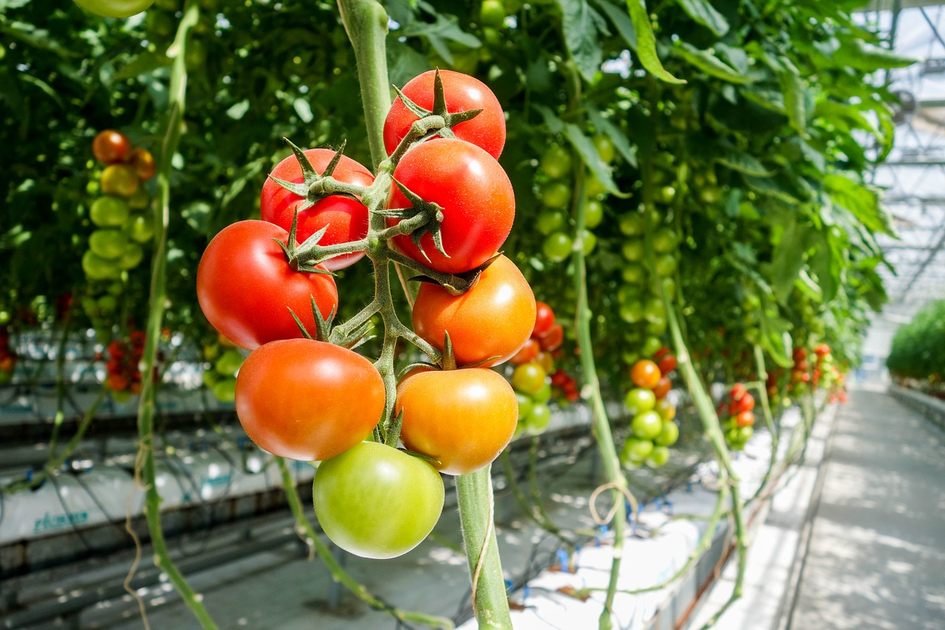
Other factors to consider…
Out of season production - versus - importing
Case study: Tomatoes
Tomatoes grown in the UK only produce fruit between June and November without the use of artificial heat.
It is estimated that emissions due to growing tomatoes commercially out of season in the UK and Northern Europe more widely, is between 2,000,000 and 4,000,000 gm CO₂ per tonne.
This is due almost entirely to the need to heat the greenhouses.
Meanwhile tomatoes from Spain and Morocco are available all year round, and these are grown using the sun’s heat, but are transported to the UK by road and/or boat.
So if you look back to the calculations from activity 3, you can see that even though the emissions from transporting tomatoes from Morocco was higher than the ones from Lancashire, if tomatoes are out of season in the UK, carbon emissions are lower by buying produce from Morocco than growing in a heated greenhouse in the UK.

Slide 26
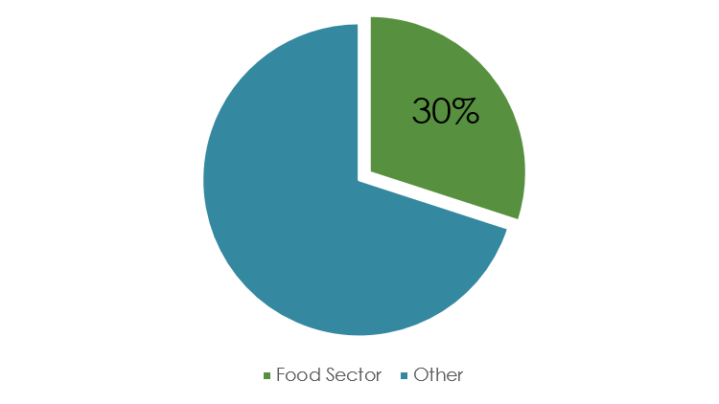
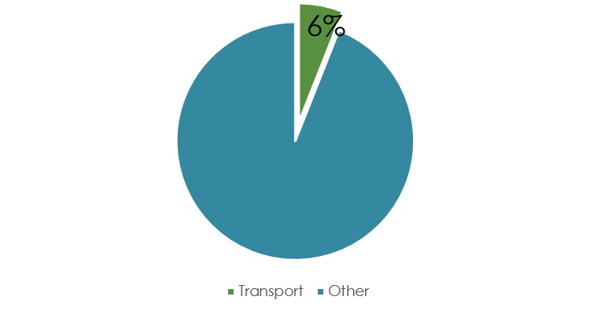
Food miles in context
Carbon Emissions
x7
The food sector accounts for up to 30% of all global green house gas (GHG) emissions.
Transport accounts for 6% of all GHG emissions produced within the food sector.
Transport
Kitchen Appliances
Notes:
1- food sector accounts for up to 30% of all global carbon emissions
2 – transport accounts for 6% of the carbon emissions from the food sector
3 – Kitchen appliances produce 7 times more carbon emissions than transport within the food sector. End consumer uses most energy of all the food sector.

Slide 27
What other miles are involved?
processing
Primary producer
Consumer
depots
packaging
abattoirs
Can you think of any additional miles?

Slide 28
Other factors affecting what we buy
Pricing
Seasonal restrictions and availability
Ethics
Convenience and choice
Notes:
Price – do we prefer to pay less for products? - financial versus environmental costs.
Seasonal restrictions and availability – should we only buy what is in season?
Global knock on effects - India (2018-19) exported £3.6bn worth of Basmati rice, if we stopped global exportation to reduce food miles what effect would it have across the globe, from economies to small farm owners.
Convenience and choice – would we travel to a different supermarket to buy more environmentally friendly sourced products, or would we prefer to just buy what is readily available to us? For example, when looking at our recipe cards, all the product information that is red is a product that is available at another shop – would you go to different shop to buy a product with less food miles or buy the product which has higher food miles as it is at the shop you are at?
Ethics – Does how the produce is farmed affect whether we want to buy it for example, free range v battery chickens, organic or non organic etc. UK battery chickens are reared at 13 birds per m2, (33kg/m2), compared to EU regulations which allow up to 17 birds per m2 (42kg/m2)

Slide 29
Challenge!
We hope you are feeling inspired to continue your journey through Conscious Consumerism.
If so have a go at one of the following two challenges:
Design communication materials to dispel common myths and help people gain a better understanding of the topic. This could be in the form of a blog, a poster, leaflets or a podcast for example.
Develop a campaign to collect real data and report your findings or to encourage people or companies to change behaviours. For example, you could collect data from your school canteen to measure the food miles of the ingredients used, or you could create recipe cards to feed your gut microbes.
See page 11 of the workbook for more details!
These resources were produced
by;
Supported by;
Funded by;

